Slide 1
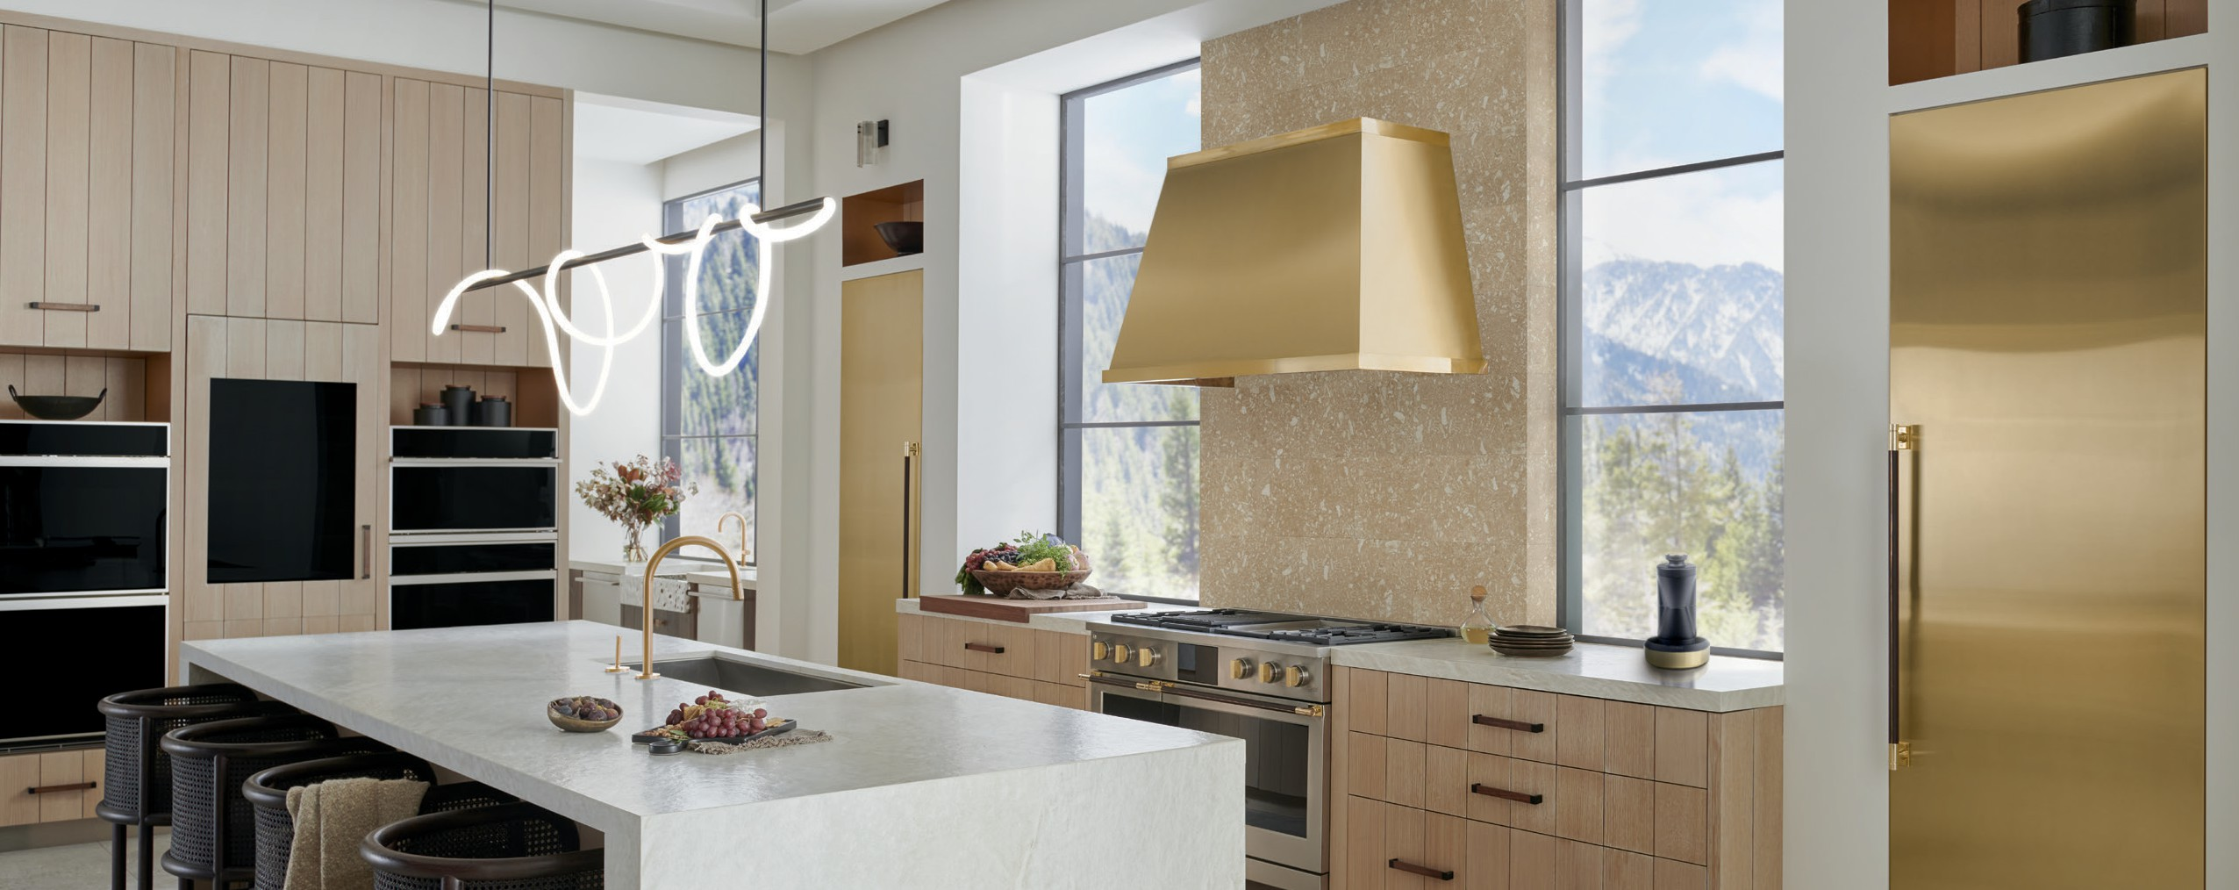
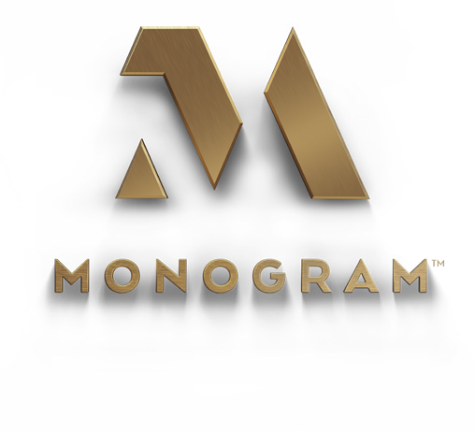

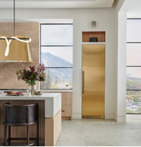
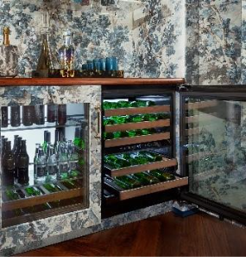
Top Monogram Products
2025 WestEdge Design Fair
This year at the WestEdge Design Fair, Monogram will spotlight its portfolio of products that combine the finest materials with unmatched performance. Each piece reflects the brand’s commitment to American craftsmanship, with the majority of its products thoughtfully designed and produced in our manufacturing facilities in Connecticut, Georgia, Kentucky and Tennessee — where precision, craftsmanship, and hand-selected materials come together. Visit us in the American Style Connoisseur’s Club in Booth #315 to experience Monogram’s elevated approach to luxury design.
1. Monogram Designer Collection - Created in collaboration with renowned interior designer and Monogram Creative Director Richard T. Anuszkiewicz, the Monogram Designer Collection offers custom handles, ventilation hoods and refrigeration panels. Available in two aesthetics, Brass and Titanium, attendees can see how Richard's vision and inspiration from fine jewelry comes to life in the polished hues of the Monogram Column Brass Handle Kit and Monogram 30” Column Brass Panel. Handcrafted in our micro-factory in Louisville, Kentucky, the brass panels offers a bold aesthetic as the industry’s first-ever custom 96-inch high refrigeration panels. Paired with the Monogram Column Brass Handle Kit with hardware wrapped in sustainability-sourced Greengard Certified Leather, the result is an elevated expression of style and proportions. The panels will be showcased on the Monogram 30" Panel Ready Premium Integrated Column Refrigerator and the Monogram 30" Panel-Ready Premium Integrated Column Freezer. Both appliances feature a fully integrated column design that creates a flush, seamless appearance with LED interior lighting for easy viewing. (Column freezer and refrigerator start at $8,900, brass panels starts at $3,500 and brass handle kit starts at $1,300)
2. Monogram 24" Panel-Ready Wine Reserve – Designed for entertainers who want an elevated wine storage option that blends seamlessly into surrounding areas, this wine reserve offers a mix of precision and performance. Debuting earlier this year, its tailor-made to fit any space with a fully integrated panel-ready exterior and sleek black onyx interior for a bold statement. Inside, back-wall lighting and overhead LED illumination highlight every bottle, turning a collection into a curated display. Two precise temperature zones, ranging from 41°F to 61°F, create the optimal temperature storage for all bottles while six removable, full-extension walnut wood shelves showcase up to 42 bottles with effortless elegance. (Starting at $3,800)

Slide 2
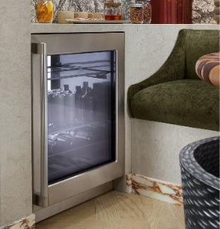
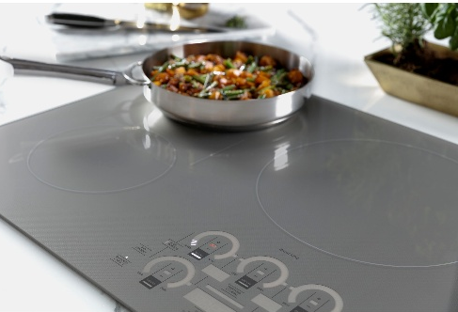
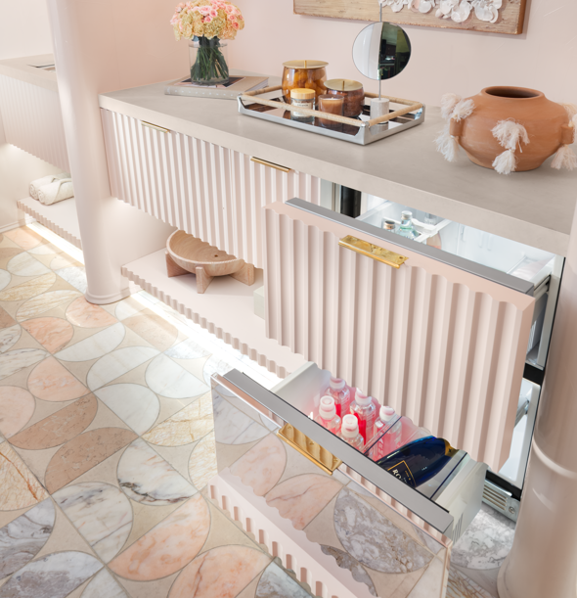
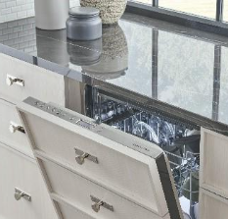


3. Monogram 24" Panel-Ready Beverage Center – Launched earlier this year, this model brings elevated versatility and thoughtful design to any entertaining space. Two removable, full-extension walnut wood shelves, three spill-proof, tempered glass shelves and one Quick Space™ shelf splits in half and slides under itself to store larger items. For a tailor-made exterior, owners can choose between a panel-ready or stainless steel design with flush installation, front leveling, and reversible door hinges for seamless integration into any space. In addition, WiFi connectivity allows owners to receive alerts on an open door, tailor interior lighting and activate a lock out mode while away for added peace of mind. (Starting at $3,000)
4. Monogram ENERGY STAR® 36" Induction Cooktop – Uniting powerful induction performance with a refined design, this cooktop elevates the experience with added connected features that make cooking on induction simpler and more precise than ever before. Five powerful burners respond instantly to every adjustment, while advanced electromagnetic technology heats only the pan, keeping the sleek glass surface cool to the touch. Available in 36" or 30" widths, the cooktop also features a smooth glass surface and Glide Touch Controls that give owners full control through effortless touch. (Starting at $3,600)
5. Monogram 24" Double-Drawer Refrigerator – Monogram refrigerator drawers are a design-forward solution for spaces like bathrooms, home gyms, bars or secondary kitchen areas. The drawers are designed to seamlessly integrate into any space in the home with a custom panel and handle to create a cohesive look. Plus, full-width LED lighting and exact temperature control between 34° and 45°F means everything from sparkling water to a refreshing face mask can be stored in their ideal climate.(Starting at $3,350)
6. Monogram 24" Panel-Ready Fully Integrated Dishwasher – Crafted for those who curate every detail, this dishwasher can be combined with a custom panel for a look tailored to your style. Designed with advanced sound-absorbing materials, it operates at a 39 DBA for a quiet experience. On the interior, an adjustable third rack easily accommodates an entire flatware collection, plus carving knives, soup ladles and other cooking and serving tools for the ultimate clean. (Starting at $2,350)

